Slide 1
ProjectName:Hotel Booking Data Analysis
Student Name:Saini.Sandhyarani
Mentor Name: Sharayoo Dixit

Slide 2
Introduction of the Project
The hospitality industry is a dynamic and data-driven sector,where hotel data analysis plays a crucial role in understanding guest behaviour, optimizing operations,and boosting revenue.Hotels can gain valuable insights into booking patterns,booking cancellation analysis, customer behavioral segmentation,revenue management,operational efficiency,loyalty programs and repeat business, customer satisfaction, marketing and sales optimization by analyzing vast amounts of given data.
Adam, a skilled data analyst at the leading data analytics company ABC. Inc.., has been tasked by the company’s manager to analyze a massive dataset of hotel booking to identify trends and patterns. However, the large volume of data and the complexity of user behavior pose challenges in extracting meaningful insights manually..

Slide 3
OBJECTIVES
The objective of the project to analyze a hotel dataset to optimize various aspects of operations,boost revenue streams, and create a more efficient and satisfying experience for guests.
Extract actionable insights from the provided data,focusing on key area such as booking patterns,customer behavioral segmentation,operational efficiency and more.
The objective of this sprint is to clean the dataset,analyze data regarding booking patterns,cancellations,customer behavioral segmentation,the perspective of revenue management,operational efficiency,loyalty programs, and repeat business.then summarize the key findings.

Slide 4
Over all Business Conclusion
Hotel Booking Data Analysis
Project 1: to clean the dataset,analyze data regarding booking patterns,cancellations,customer behavioral segmentation,the perspective of revenue management,operational efficienc,loyalty programs, and repeat business.
Project2:In this project we continuing with the analysis of hotel data encompassing is to delve into customer satisfaction,marketing strategies, and sales optimization.

Slide 5
Project part1
Data Cleaning:we have 2097 rows in this hotel booking data. Columns: There are 32 columns in the DataFrame, including information about the reservation, guests, and booking details.
Data Types: Some columns contain numerical data (e.g., lead_time, adults, adr), while others contain categorical data (e.g., hotel, arrival_date_month, reservation_status).
Missing Values: There are missing values in some columns, such as "reservation_status_date" and potentially "agent" and "company".
Here are some initial observations you can make from the data without any further analysis:
The dataset covers bookings from at least 2015 to 2017 (based on arrival_date_year).
The average stay duration is slightly longer than 2 nights (1.92 nights on weekdays + 0.86 nights on weekends).
Most reservations involve one or two adults with no children or babies.
There are more bookings with "No Deposit" than any other deposit type.

Slide 6
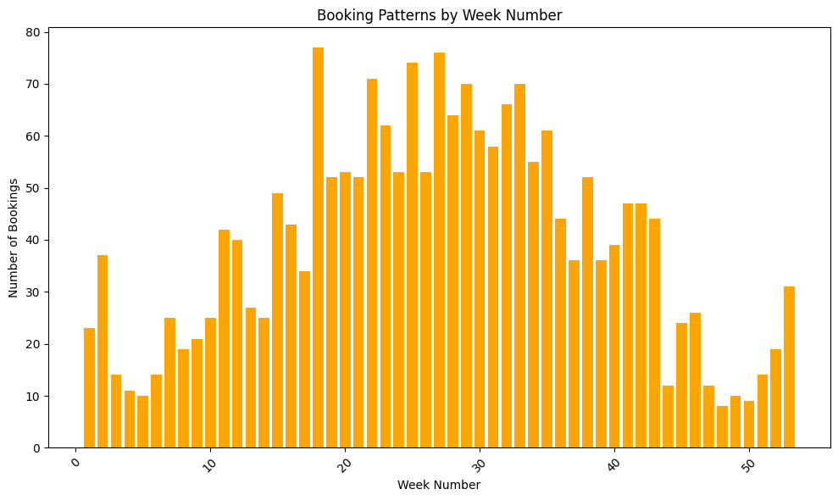
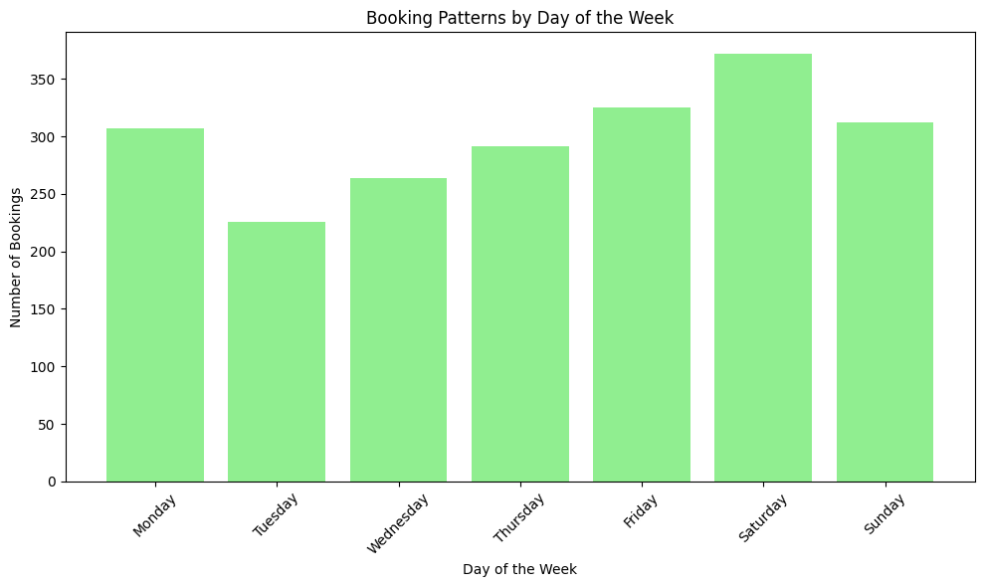
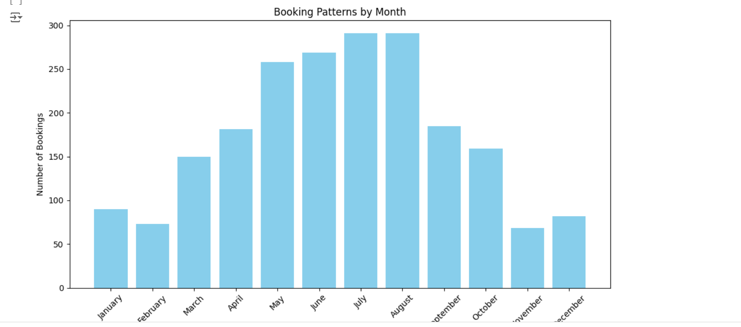
Booking Pattern Analysis
Based on these charts, we can conclude that the hotel experiences peak bookings during the summer months (June to August) and on weekends (Friday and Saturday). The off-peak seasons are January and February, with weekdays having lower booking volumes compared to weekends. This information can be valuable for the hotel management to optimize resource allocation and pricing strategies throughout the year.

Slide 7
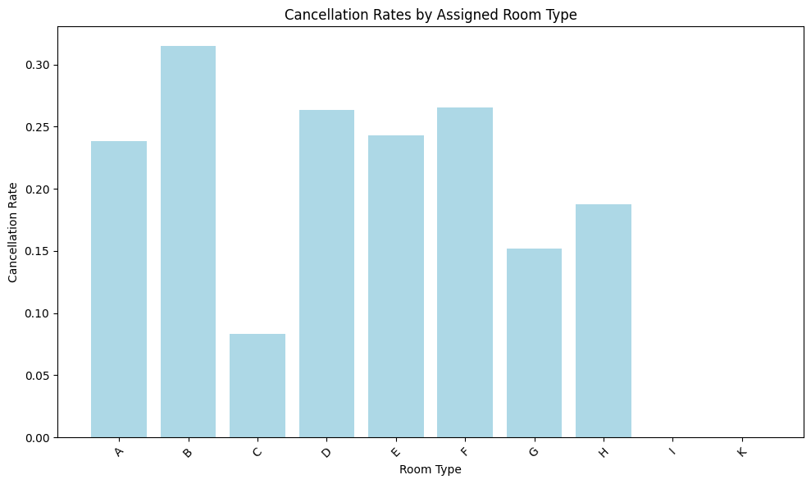
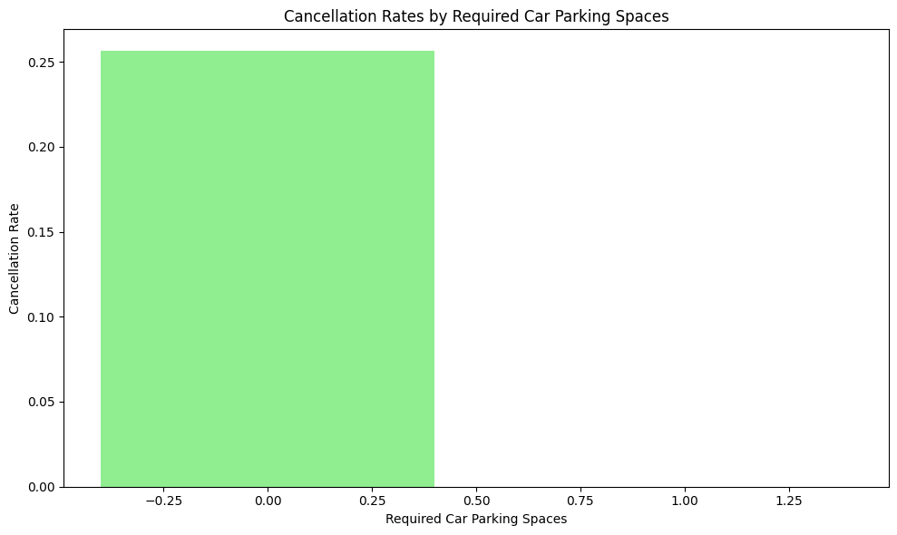
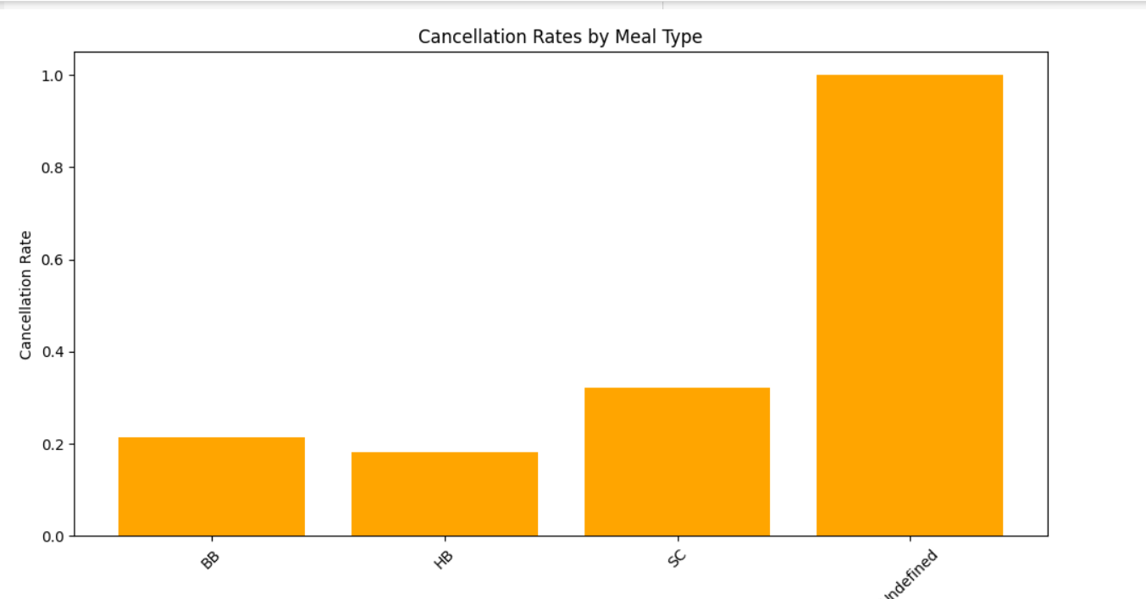
Booking Cancellation Analysis
The cancellation rate for Undefined meal type is significantly higher than the others, indicating that bookings with unspecified meal preferences are more likely to be canceled.
#room type B has many cancellations compare with other room types... There is only one bar in the chart, indicating that there is only one category for required car parking space.. The bar is tall, reaching approximately 0.25 on the y-axis, indicating a relatively high cancellation rate for bookings that require car parking spaces.
#meal type,room type,car parking spaces these factors are influence by booking patterns

Slide 8
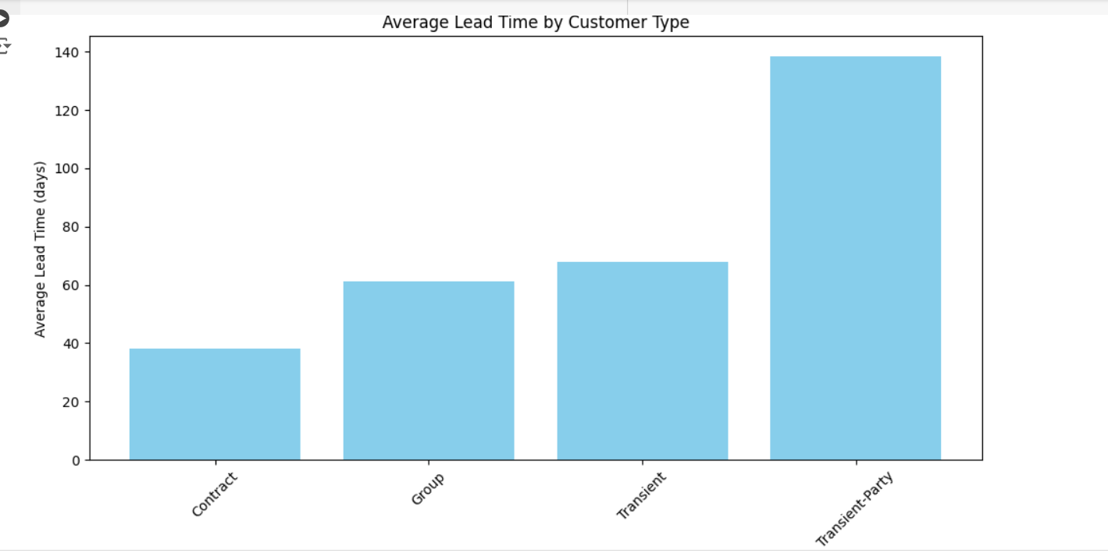
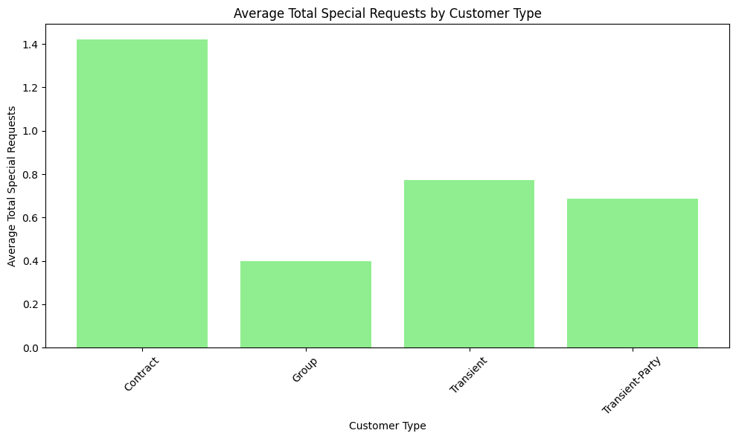
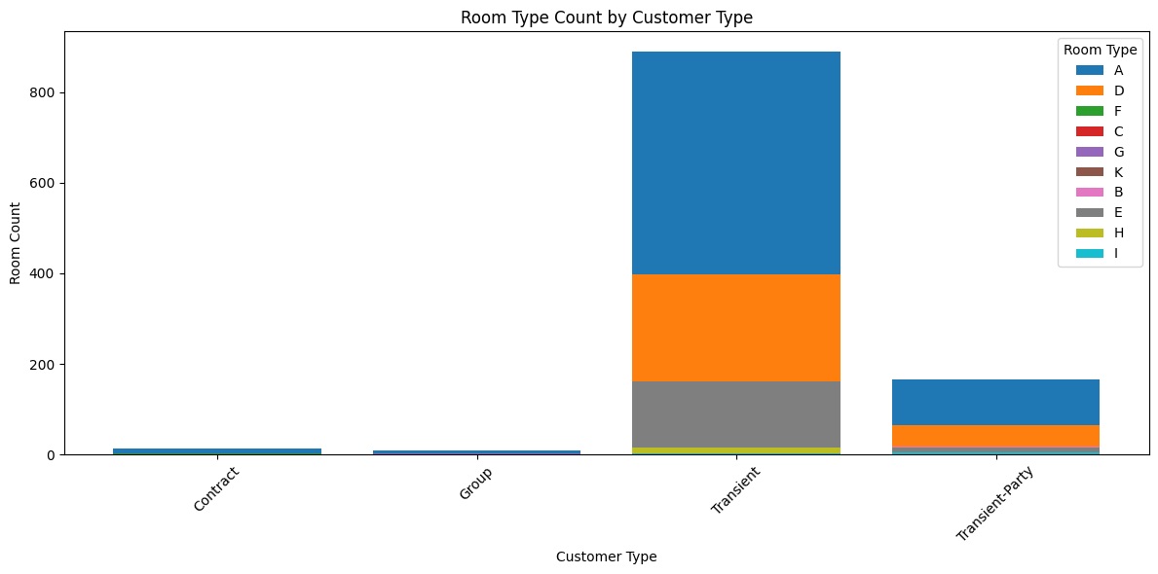
Customer Behavioral Segmentation
Transient-Party customers have the longest average lead time, followed by Group customers.Contract and Transient customers have relatively shorter average lead times.
#The specific average lead times are:Transient-Party: Approximately 140 days.#Group: Approximately 65 days.#Transient: Approximately 65 days.#Contract: Approximately 40 days.
#Contract customers have the highest average number of special requests, followed by Group customers.Transient and Transient-Party customers have relatively lower average numbers of special request
#Transient customers have the highest overall room count, followed by Transient-Party customers.Contract and Group customers have relatively lower room counts.Room Type A is the most popular room type across all customer types.

Slide 9
Revenue Management

